Slide 1
Telecom Centres of Excellence (TCOE) India IEG Interim Report – Summary A. Vibhuti and R. David Koilpillai TCOE India IEG
WP 5D IMT-2020 RIT Evaluation Workshop
Geneva, 10-11 December 2019

Slide 2



Support start-up Ecosystem
Capacity Building
Think Tank Activities for Policy Advocacy
Influencing Telecom Standards
Enabling Environment for Industry Driven R&D
Visit us at: www.tcoe.in, Email: director.cc@tcoe.in

Slide 3


IMT 2020 Evaluation team
Associations
Research institutes
Academic institutions
IISc
IITM
IITH
IITKGP
IIT – Indian Institute of Technology
IISc – Indian Institute of Science
Website link: https://imt2020-ieg-tcoe.in/members/

Slide 4
TCOE India Organizational Structure
TCOE India
Support
Liaison with ITU and External Evaluation Groups
Technical Coordinator
Academic Institutions
Research Organizations
Industry
Working group 1
Working group 2
Working group n

Slide 5
Evaluation Procedure
Work division among the evaluators
External groups
ITU
Simulator Calibration
Final Report
RIT/SRIT
Verify self-compliance
Link budget templates
TCOE India
Evaluation
(Simulation/analysis /inspection)
Compile and consolidate the results
Interim report
Notes:
Division of the work among the internal team
Based on interests and capabilities
Calibration of the simulators and channel models
Internal/External groups
Examine and understand the RIT/SRIT
Verify the self-compliance results
Link budget templates
Evaluate the TPR
Simulation, analysis and inspection
Compile and consolidate the results
Report
Approval of TCOE
Submission to ITU

Slide 6
IEG Interim Evaluation Contributors …
CEWiT
IIT Madras
IIT Hyderabad
IIT Kharagpur
IISc
WiSig
Huawei
Administrative Coordinator: Mr. Anurag Vibhuti (anurag.cc@tcoe.in)
Technical Coordinator: Dr. R. David Koilpillai (koilpillai@ee.iitm.ac.in)

Slide 7

TCOE India IEG Procedure
Division of the work among the internal teams
Based on interests and capabilities
Calibration of the simulators and channel models
Internal / External groups
Examine and understand the RIT/SRIT
Verify the self-compliance results
Evaluate the TPR
Simulation, analysis and inspection
Compile and consolidate the results
Report
Approval of TCOE India
Submission to ITU
Regular intermediate meetings
Face-to-face and Teleconference
TCOE India Technical Coordinator
Responsible for collating and delivering the IEG results

Slide 8
Usage scenarios (M.2083)
eMBB
mMTC
URLLC
Test Environments
Indoor Hotspot
eMBB
Dense Urban
eMBB
Rural
eMBB
Urban macro
mMTC
Urban
macro
URLLC
Config A
700 MHz
ISD 1.732km
120/500 km/h
Config A
ISD 500m
Config A
4 GHz
Config A
4 GHz
Config A
4 GHz (1 layer)
Config B
ISD 1.732 km
Config B
700 MHz
Config B
30 GHz
Config B
30 GHz (1 layer)
Config B
4 GHz
ISD 1.732km
120/500 km/h
Config C
70 GHz
Config C
4/30 GHz (2 layer)
Test Configurations
Blue Evaluated
Green Being evaluated
LMLC
700 MHz
ISD 6km
30 km/h
TPR are defined for
the Test Environments

Slide 9
Key References …
ITU-R M.2410: Minimum requirements (KPI)
ITU-R M.2411: Submission templates
ITU-R M.2412: Guidelines for evaluation of RIT for IMT-2020
Channel models
Simulation procedures
RITs evaluated by TCOE India IEG
TSDSI RIT ((IMT-2020 / 19), along with update (5D/1301))
3GPP RIT (IMT-2020 / 14)

Slide 10
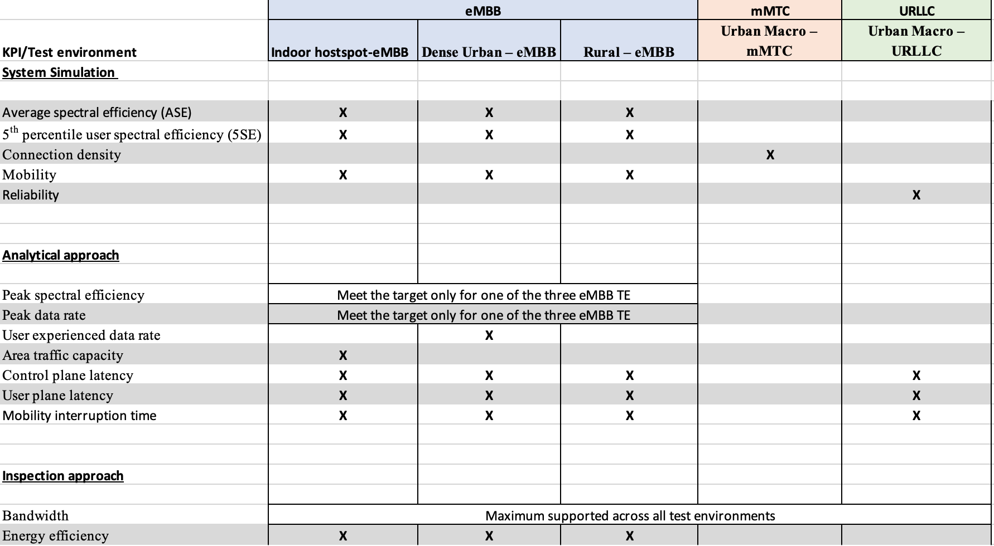
KPI and Evaluation Matrix

Slide 11
Status of TSDSI RIT Evaluation …
Simulation based KPIs evaluated
TSDSI RIT meets ITU requirements for evaluated KPIs
Analytical KPIs completed
User Experienced data rate
Area Traffic capacity
Peak Spectral efficiency
Peak data rate
Analytical KPIs to be completed
Connection density
Control Plane Latency
User Plane Latency
Mobility Interruption Time
Energy Efficiency
TSDSI RIT meets ITU requirements for all KPIs evaluated

Slide 12
Thank You !!
For additional information … anurag.cc@tcoe.in
koilpillai@ee.iitm.ac.in

